Slide 1
Chapter 4 Adv. Internetworking
Gandeva Bayu Satrya (GBS)
gbs@ittelkom.ac.id
gandeva.bayu.s@gmail.com
TELKOM ENGINEERING SCHOOL
Telkom University

Slide 2
Agenda
Chapter 4. Adv. Internetworking
Global Internet
IANA, Routing Area, BGP, IPv6
Multicast
Multicast Address, DVMRP
Multiprotocol Label Switching (MPLS)
Routing Among Mobile Devices

Slide 3

Provisioning Hierarchy
ICANN / IANA
(Internet Assigned Numbers Authority)
Manage global unallocated IP address pool
Allocate
RIRs
(AFRINIC, APNIC, ARIN, LACNIC, RIPE NCC)
Manage regional unallocated IP address pool
Allocate
Assign
ISPs
End Users
Re-Allocate
Re-Assign
ISPs
End Users

Slide 4
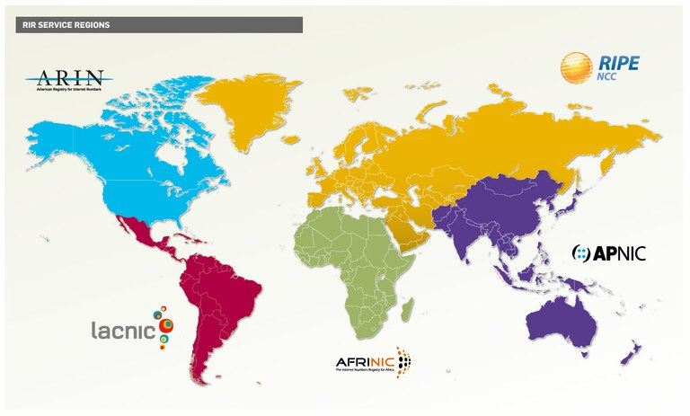
RIR Service Region
Regional Internet Registries (RIRs)
Internet Assigned Numbers Authority (IANA)

Slide 5
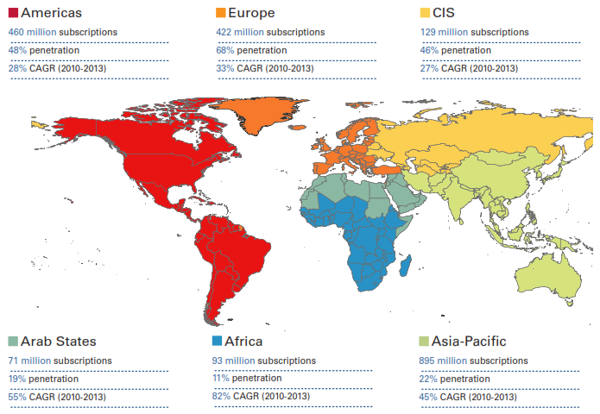
Subscriptions WWW in 2013
Source : ITU World Telecommunication

Slide 6
Problems
Identification :
Internet’s topology has grown much more complex than this ﬁgure suggests.
each provider and end-user is likely to be an administratively independent entity.
Problem Solving
The ﬁrst is the scalability of routing. (AS & CIDR)
We need to ﬁnd ways to minimize the number of network numbers that get carried around in routing protocols and stored in the routing tables of routers.
The second is address utilization. (IPv6)
That is, making sure that the IP address space does not get consumed too quickly.

Slide 7
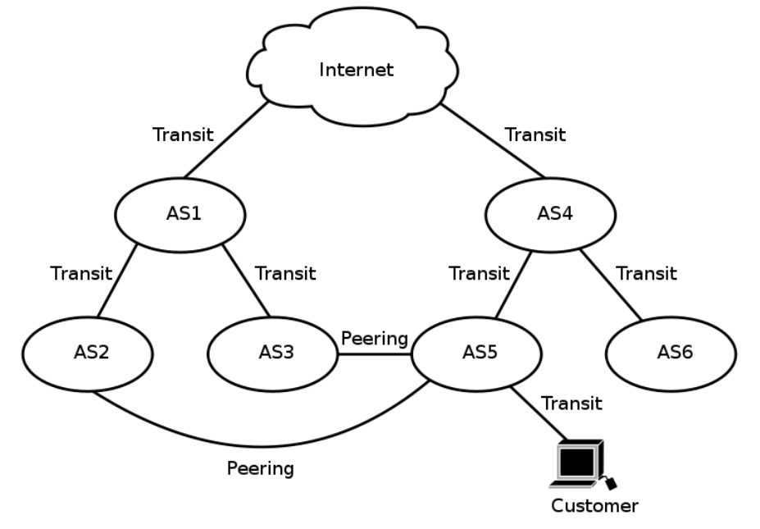
The Global Internet

Slide 8
Routing Area
We’ll examine how link-state routing protocols (such as OSPF and IS-IS) can be used to partition a routing domain into subdomains called areas.
An area is a set of routers that are administratively conﬁgured to exchange link-state information with each other.
There is one special area—the Backbone Area, also known as area 0.

Slide 9
Routing Area

Slide 10
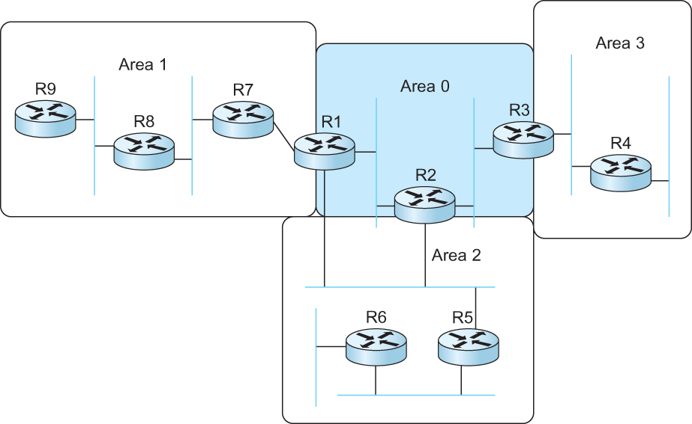
Routing Area
A domain divided into Area

Slide 11
Interdomain Routing (BGP)
Internet is organized as Autonomous Systems (AS) each of which is under the control of a single administrative entity
Autonomous System (AS)
corresponds to an administrative domain
examples: University, company, backbone network
A corporation’s Internal Network might be a single AS, as may the network of a single Internet Service Provider.

Slide 12
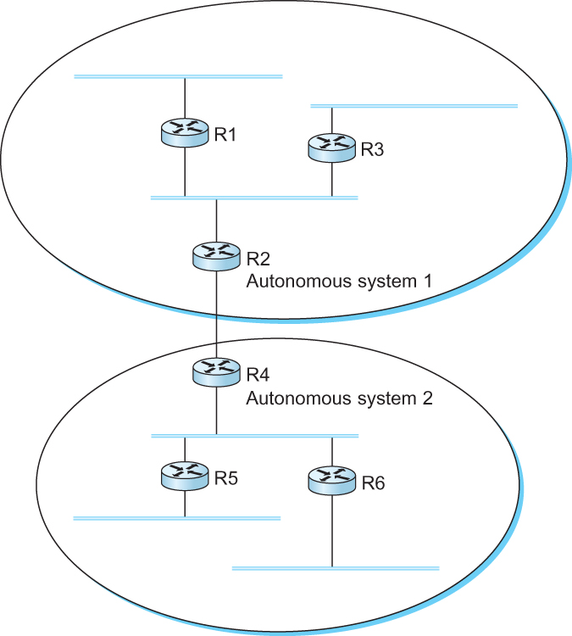
Interdomain Routing (BGP)
A network with two autonomous system

Slide 13
Route Propagation
Idea: Provide an additional way to hierarchically aggregate routing information in a large internet.
Improves scalability
Divide the routing problem in two parts:
Routing within a single autonomous system
Routing between autonomous systems
Another name for autonomous systems in the Internet is routing domains
Two-level route propagation hierarchy
Inter-domain routing protocol (Internet-wide standard)
Intra-domain routing protocol (each AS selects its own)

Slide 14
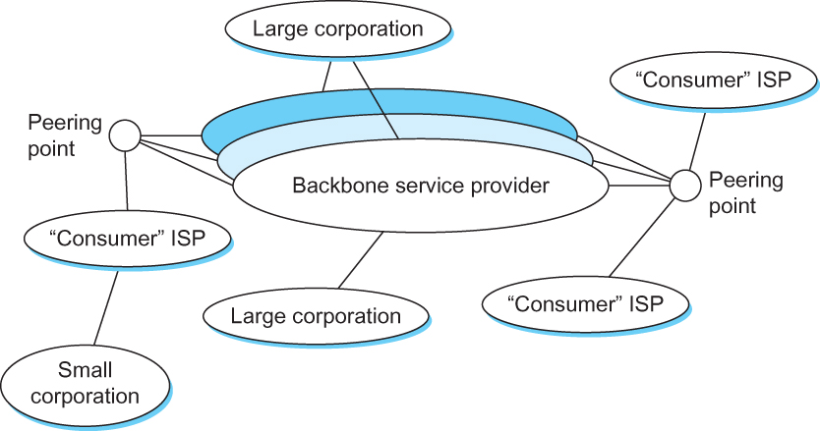
The Global Internet
MultihomedAS
Transit AS
Stub AS
Stub AS: an AS that has only a single connection to one other AS; such an AS will only carry local traffic.
Multihomed AS: an AS that has connections to more than one other AS, but refuses to carry transit traffic.
Transit AS: an AS that has connections to more than one other AS, and is designed to carry both transit and local traffic.

Slide 15
EGP and BGP
Inter-domain Routing Protocols
Exterior Gateway Protocol (EGP)
Forced a tree-like topology onto the Internet
Did not allow for the topology to become general
Tree like structure: there is a single backbone and autonomous systems are connected only as parents and children and not as peers
Border Gateway Protocol (BGP)
Assumes that the Internet is an arbitrarily interconnected set of ASs.
Today’s Internet consists of an interconnection of multiple backbone networks (they are usually called service provider networks, and they are operated by private companies rather than the government)
Sites are connected to each other in arbitrary ways

Slide 16
Routing Protocol
REMEMBER ME…!!!

Slide 17
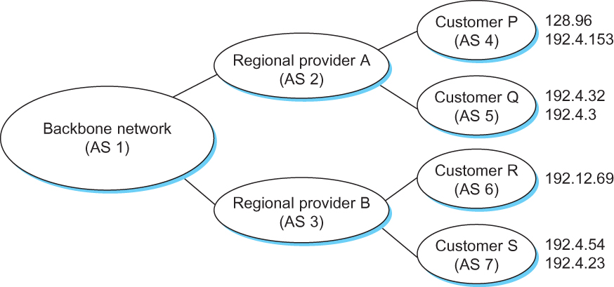
BGP Example
Example of a network running BGP

Slide 18
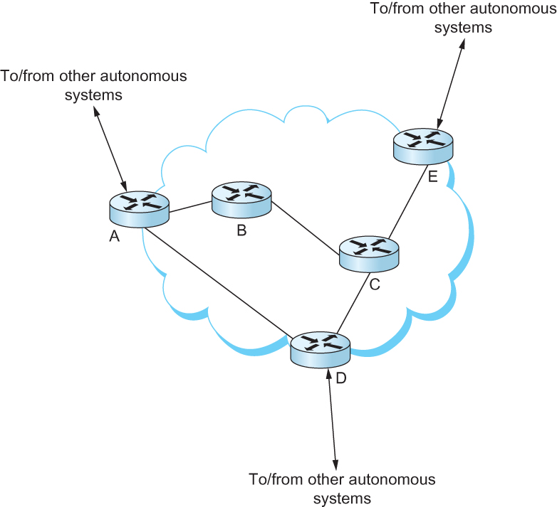
Interdomain and Intradomain
iBGP
eBGP
All routers run an intradomain routing protocol (RIP/ OSPF).
Border routers (A, D, E) also run BGP to other ASs

Slide 19
Need IPv6 ???
In IPv4 we have VLSM/CIDR and NAT.
IPv4 has only about 4.3 billion addresses available—in theory.
There really are only about 250 million addresses that can he assigned to devices.
The fact that there are about 6.5 billion people in the world today. [LAMMLE-2007]
Now, the number of people and devices that connect to networks increases each and every day.
The Next-Generation Internet Protocol – IPV6.

Slide 20
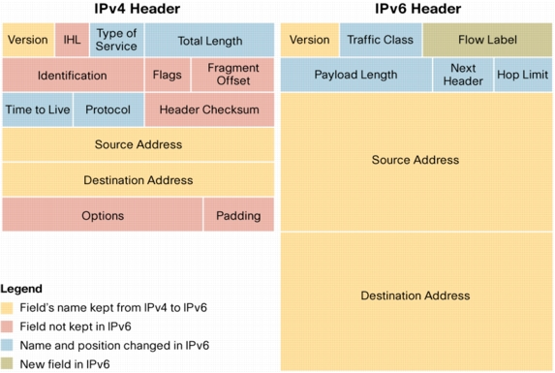
IPv4 and IPv6 Headers

Slide 21
IPv6 is…
IPv6, formerly named IPng (next generation), is the latest version of the Internet Protocol (IP).
IP is a packet-based protocol used to exchange data, voice, and video traffic over digital networks.
IPv6 quadruples the number of network address bits from 32 bits (in IPv4) to 128 bits.

Slide 22
Benefits of IPv6
Flexibility
Shortened Expression
Efficiency
A lot of address (3.4x 10³⁸ ≈ definitely enough)
Capability
Migrating to IPV6 (tunnel or dual stack)
Support Security and Mobility
Extension's header IPv6

Slide 23

IPv6 Addressing
Actually 128 bits in length.
The address is expressed in hexadecimal just like a MAC address is, so you could say this address has eight 16-bit hexadecimal colon-delimited blocks.
How about HTTP connection in IPv6?

Slide 24
Address Allocation Policy
/23
/32
/48
/64
2001
0410
Interface ID
Registry
ISP prefix
Site prefix
Bootstrap process - RFC2450
LAN prefix
The allocation process is under reviewed by the Registries:
IANA allocates 2001::/16 to registries
Each registry gets a /23 prefix from IANA
Formely, all ISP were getting a /35
With the new policy, Registry allocates a /32 prefix to an IPv6 ISP
Then the ISP allocates a /48 prefix to each customer (or potentially /64)
ftp://ftp.cs.duke.edu/pub/narten/ietf/global-ipv6-assign-2002-06-26.txt
Notes:
The generic allocation process is:
IANA allocates 2001::/16 to registries from the full address space
Slow-start allocation process:
Each registry gets a /23 prefix from IANA, within the 2001::/16 space
Registry allocates an initial /32 prefix to a new IPv6 ISP
ISP allocates a /48 prefix (out of the /32) to each customer

Slide 25
Interface IDs
Lowest-order 64-bit field of unicast address may be assigned in several different ways:
auto-configured from a 64-bit EUI-64, or expanded from a 48-bit MAC address (e.g., Ethernet address)
auto-generated pseudo-random number (to address privacy concerns)
assigned via DHCP
manually configured
Notes:
Current LANs like Ethernet use 48-bit MAC addresses defined by the IEEE 802 standards. The IEEE has introduced a new, 64-bit address space called EUI-64, for new kinds of LANs. There is a standard mapping from a 48-bit MAC into a 64-bit EUI-64.

Slide 26
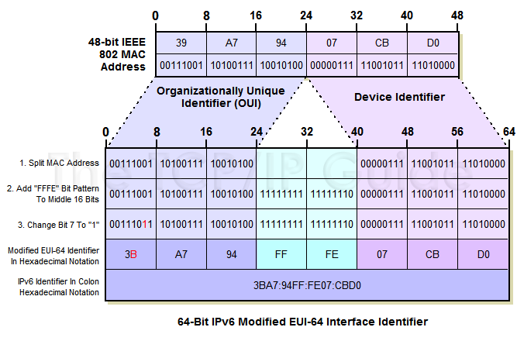
Modified EUI-64 Interface ID

Slide 27
Address Type
We're all familiar with IPv4’s unicast, broadcast, and multicast addresses that basically define who or at least how many other devices we're talking to.
IPv6 adds to that trio and introduces the anycast. Broadcasts, as we know them, have been eliminated in IPv6 because of their cumbersome inefficiency.
Type of IPv6 Addressing
Unicast , Global Unicast Addresses, Link-local Addresses, Unique Local Addresses, Multicast, and Anycast

Slide 28
Types of IPv6 Addresses
Unicast
Address of a single interface
Delivery to single interface
Multicast
Address of a set of interfaces
Delivery to all interfaces in the set
Anycast
Address of a set of interfaces
Delivery to a single interface in the set
No more broadcast addresses

Slide 29
Discovery Protocol
The process of resolving a destination’s IP address to that destination’s MAC address is referred to as, unsurprisingly, address resolution.
In IPv4. this task is performed by the Address Resolution Protocol (ARP). In IPv6, this function is performed by the Neighbor Discovery protocol (ND).

Slide 30
IPv6 Neighbor Discovery
Neighbor discovery is a function that enables a node to identify other hosts and routers on its links.
The node needs to know of at least one router so that it knows where to forward packets if a target node is not on its local link.
Neighbor discovery also allows a router to redirect a node to use a more appropriate router if the node has initially made an incorrect choice.
There are two ways that neighbor discovery are performed in IPv6. Statelessly via ICMPv6 and Statefuly via DHCPv6.

Slide 31
Migration Techniques
A wide range of techniques have been identified and implemented, basically falling into three categories:
(1) dual-stack techniques, to allow IPv4 and IPv6 to co-exist in the same devices and networks
(2) tunneling techniques, to avoid order dependencies when upgrading hosts, routers, or regions
(3) translation techniques, to allow IPv6-only devices to communicate with IPv4-only devices
Expect all of these to be used, in combination

Slide 32
Ex 1: 6to4 Tunnel
2002:8243:1::/48
2002:947A:1::/48
IPv6
IPv4
IPv6
130.67.0.1
148.122.0.1
11.0.0.1
6to4 prefix is 2002::/16 + IPv4 address. 2002:a.b.c.d::/48
IPv6 Internet
6to4 relay 2002:B00:1::1 Announces 2002::/16 to the IPv6 Internet

Slide 33
Ex 2: Configured Tunnel
3ffe:c00:2::/48
3ffe:c00:1::/48
IPv4
IPv6
IPv6
130.67.0.1
148.122.0.1
-------------------------------------- |IPv4 header|IPv6 header IPv6 payload| -------------------------------------- IPv4 protocol type = 41

Slide 34
Agenda
Chapter 4. Adv. Internetworking
Global Internet
IANA, Routing Area, BGP, IPv6
Multicast
Multicast Address, IGMP, Multicast Routing, DVMRP
Multiprotocol Label Switching (MPLS)
Routing Among Mobile Devices

Slide 35
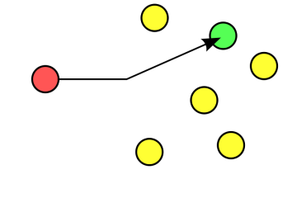
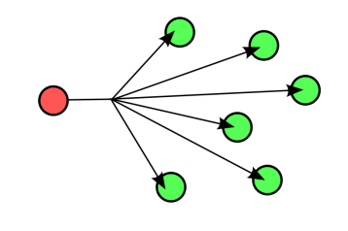
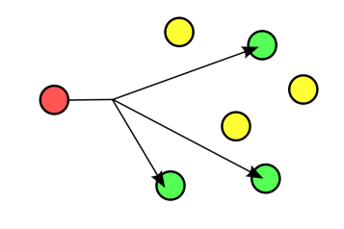
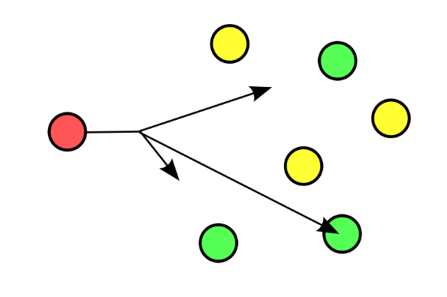
Trio Cast
UNICAST
BROADCAST
MULTICAST
ANYCAST (IPV6)

Slide 36
Overview
Example Analogy Multicast :
One-to-many
Radio station broadcast
Transmitting news, stock-price
Software updates to multiple hosts
Many-to-many
Multimedia teleconferencing
Online multi-player games
Distributed simulations

Slide 37
Problem Identification
Without multicast support:
A source needs to send a separate packet with the identical data to each member of the group
This redundancy consumes more bandwidth
Redundant traffic is not evenly distributed, concentrated near the sending host
Source needs to keep track of the IP address of each member in the group
Group may be dynamic
To support many-to-many and one-to-many IP provides an IP-level multicast

Slide 38
Overview M’cast
Basic IP multicast model is many-to-many based on multicast groups
Each group has its own IP multicast address
Hosts that are members of a group receive copies of any packets sent to that group’s multicast address
A host can be in multiple groups
A host can join and leave groups

Slide 39
Overview M’cast
Using IP multicast to send the identical packet to each member of the group
A host sends a single copy of the packet addressed to the group’s multicast address
The sending host does not need to know the individual unicast IP address of each member
Sending host does not send multiple copies of the packet

Slide 40
Overview M’cast
One-to-many multicast
Source specific multicast (SSM)
A receiving host specifies both a multicast group and a specific sending host
Many-to-many model
Any source multicast (ASM)

Slide 41
IGMP
How does a group get started and how does it terminate?
How is the group address chosen?
How are new hosts added to the group (either as senders or receivers)?
Can anyone join a group (and send to, or receive from, that group) or is group membership restricted and, if so, by whom?
Do group members know the identities of the other group members as part of the network-layer protocol?
How do the network nodes interoperate with each other to deliver a multicast datagram to all group members?
Internet Group Management Protocol (IGMP)

Slide 42
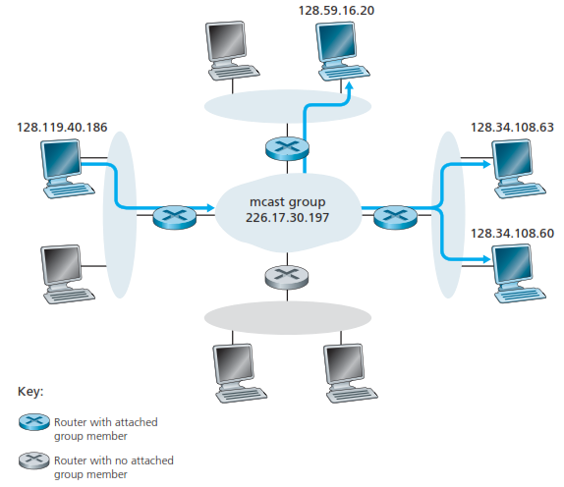
IGMP

Slide 43
Multicast Group
A host signals its desire to join or leave a multicast group by communicating with its local router using a special protocol
In IPv4, the protocol is Internet Group Management Protocol (IGMP)
In IPv6, the protocol is Multicast Listener Discovery (MLD)
The router has the responsibility for making multicast behave correctly with regard to the host

Slide 44
Multicast Routing

Slide 45
Multicast Routing
To support multicast, a router must additionally have multicast forwarding tables that indicate, based on multicast address, which links to use to forward the multicast packet
Unicast forwarding tables collectively specify a set of paths
Multicast forwarding tables collectively specify a set of trees
Multicast distribution trees

Slide 46
Multicast Routing
To support source specific multicast, the multicast forwarding tables must indicate which links to use based on the combination of multicast address and the unicast IP address of the source
Multicast Routing is the process by which multicast distribution trees are determined.

Slide 47
Distance-Vector Multicast
DVMRP is one of several multicast routing protocols described as ﬂood-and-prune protocols.
Given a unicast routing table, each router knows that the current shortest path to a given destination goes through NextHop.
Thus, whenever it receives a multicast packet from source S, the router forwards the packet on all outgoing links (except the one on which the packet arrived)
IFF the packet arrived over the link that is on the shortest path to S (i.e., the packet came from the NextHop associated with S in the routing table).
This strategy effectively ﬂoods packets outward from S but does not loop packets back toward S.

Slide 48
Distance-Vector Multicast
Reverse Path Broadcast (RPB)
Goal: Prune networks that have no hosts in group G
Step 1: Determine LAN that is a leaf with no members in G
leaf if parent is only router on the LAN
determine if any hosts are members of G using IGMP
Step 2: Propagate “no members of G here” information
augment <Destination, Cost> update sent to neighbors with set of groups for which this network is interested in receiving multicast packets.
only happens when multicast address becomes active.

Slide 49
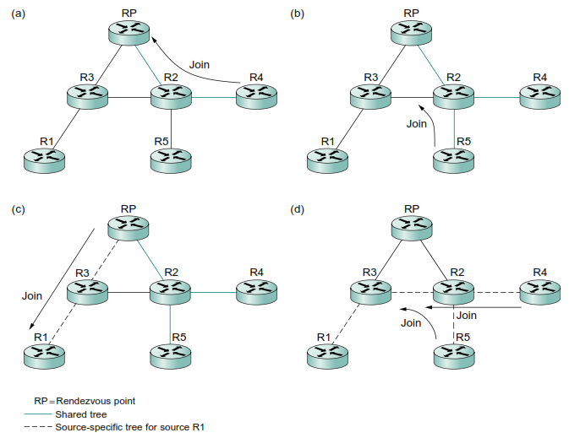
Protocol Independent Multicast (PIM)

Slide 50
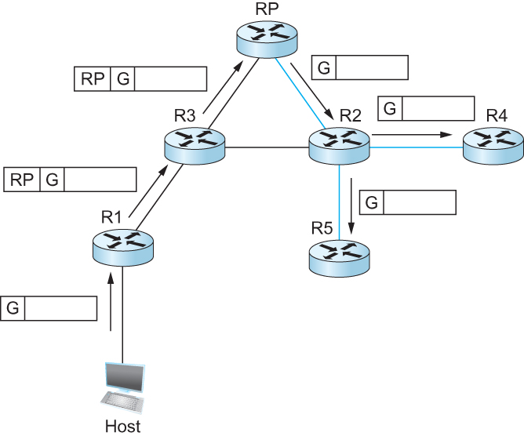
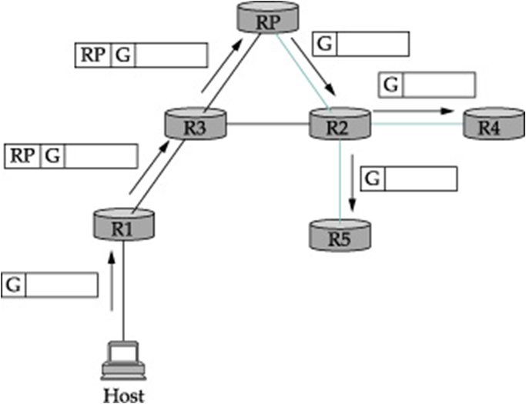
Protocol Independent Multicast (PIM)
Delivery of a packet along a shared tree. R1 tunnels the packet to the RP, which forwards it along the shared tree to R4 and R5.

Slide 51
Interdomain Multicast
The PIM-SM protocol is typically not used across domains, only within a domain.
To extend multicast across domains using PIM-SM, the Multicast Source Discovery Protocol (MSDP).
MSDP is used to connect different domains—each running PIM-SM internally, with its own RPs—by connecting the RPs of the different domains.
Each RP has one or more MSDP peer RPs in other domains.
Each pair of MSDP peers is connected by a TCP connection over which the MSDP protocol runs.

Slide 52
Source-Specific Multicast (SSM)
In the original PIM design, this optimization was invisible to hosts—only routers joined source-speciﬁc trees.
However, once the need for a one-to-many service model was recognized, it was decided to make the source-speciﬁc routing capability of PIM-SM explicitly available to hosts.
PIM-SSM introduces a new concept, the channel, which is the combination of a source address S and a group address G. The group address G looks just like a normal IP multicast address, and both IPv4 and IPv6 have allocated subranges of the multicast address space for SSM.

Slide 53
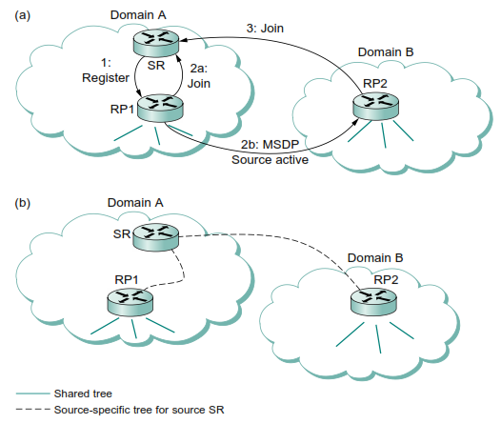
Source-Specific Multicast (SSM)
Notes:
MSDP operation:
(a) The source SR sends a Register to its domain’s RP, RP1; then RP1 sends a source-specific Join to SR and an MSDP Source Active to its MSDP peer in Domain B, RP2; then RP2 sends a source-specific Join to SR.
(b) As a result, RP1 and RP2 are in the source-specific tree for source SR.

Slide 54
Bidirectional Trees (BIDIR-PIM)
BIDIR-PIM is a recent variant of PIMSM that is well suited to many-to-many multicasting within a domain, especially when senders and receivers to a group may be the same, as in a multiparty videoconference.
BIDIR-PIM’s trees are bidirectional—a router that receives a multicast packet from a downstream branch can forward it both up the tree and down other branches.

Slide 55
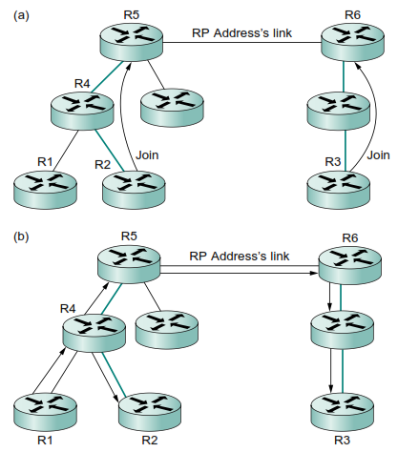
Bidirectional Trees (BIDIR-PIM)
Notes:
BIDIR-PIM operation:
(a) R2 and R3 send Joins toward the RP address that terminate when they reach a router on the RP address’s link.
(b) A multicast packet from R1 is forwarded upstream to the RP address’s link and downstream wherever it intersects a group member branch.

Slide 56
Bibliography
Kurose, J.F., and Ross, K.W., Computer Networking : A Top-Down Approach Sixth Edition, Pearson Education, Inc. USA, 2013.
Lammle T., Cisco Certified Network Associate : Study Guide Fifth Edition, Sybex, Inc. USA, 2005.
Peterson, L.L., and Davie, B.S., Computer Networks: A Systems Approach Fifth Edition, Morgan Kaufmann, Burlington USA, 2012.
Tanenbaum, A.S., and Wetherall, D.J., Computer Networks Fifth Edition, Pearson Education, Inc., Boston USA, 2011.

Slide 57
THANK YOU
Gandeva Bayu Satrya (GBS)
gbs@ittelkom.ac.id
gandeva.bayu.s@gmail.com
TELKOM ENGINEERING SCHOOL
Telkom University

